Slide 1
Chapter-2
The Recording Process

Slide 2
Describe how accounts, debits, and credits are used to record business transactions.
The
Account
Record of increases and decreases in a specific asset, liability, owners’ equity, revenue, or expense item.
Debit = “Left”
Credit = “Right”

Slide 3
The Account
DEBIT AND CREDIT PROCEDURES
Double-entry system
  Each transaction must affect two or more accounts to keep the basic accounting equation in balance.
  Recording done by debiting at least one account and crediting at least one other account.
  DEBITS must equal CREDITS.

Slide 4
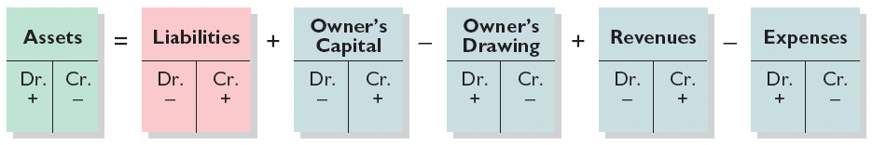
Summary of Debit/Credit Rules
Relationship among the assets, liabilities and owner’s equity of a business:
Illustration 2-11
Basic Equation
Assets = Liabilities +
Owner’s Equity
Expanded Equation
Debit/Credit Effects
The equation must be in balance after every transaction. Total Debits must equal total Credits. Normal Balance is on the Increase Side.

Slide 5
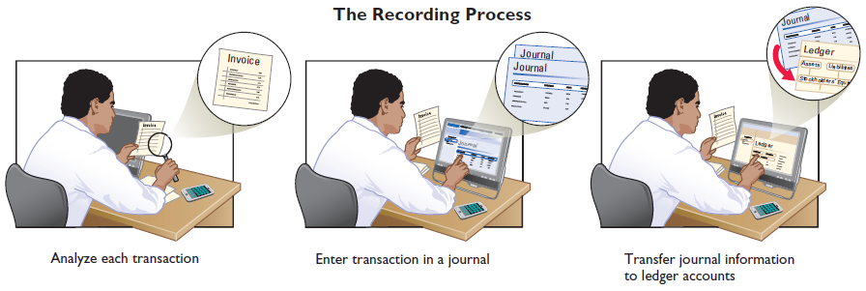
Indicate how a journal is used in the recording process.
Steps in the Recording Process
Illustration 2-12
Analyze each transaction
Enter transaction in a journal
Transfer journal information to ledger accounts
Business documents, such as a sales slip, a check, or a bill, provide evidence of the transaction.

Slide 6
Steps in the Recording Process
The Journal
Book of original entry.
Transactions recorded in chronological order.
Contributions to the recording process:
  Discloses the complete effects of a transaction.
  Provides a chronological record of transactions.
  Helps to prevent or locate errors because the debit and credit amounts can be easily compared.

Slide 7
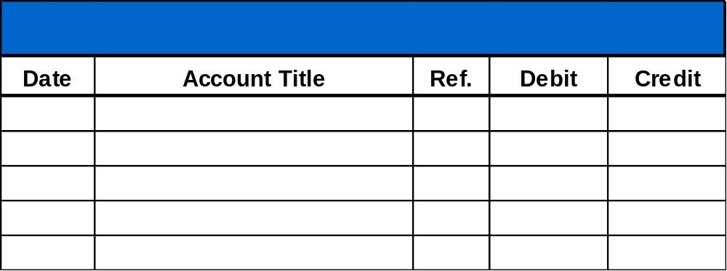
Steps in the Recording Process
JOURNALIZING - Entering transaction data in the journal.
Illustration: On September 1, Ray Neal invested $15,000 cash in the business, and Softbyte purchased computer equipment for $7,000 cash.
Illustration 2-13
GENERAL JOURNAL
Sept. 1
Cash
15,000
  Owner’s Capital
15,000
Equipment
7,000
  Cash
7,000

Slide 8
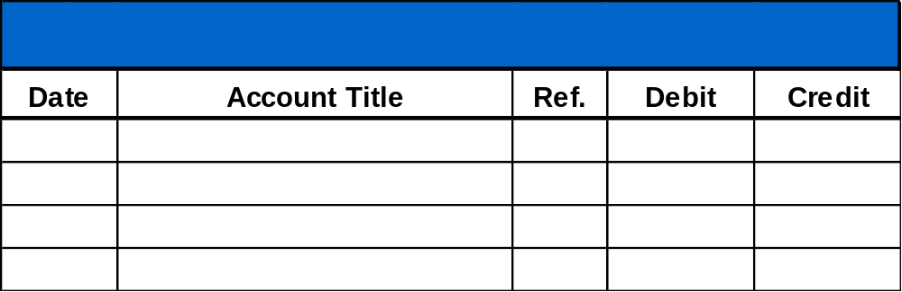
Steps in the Recording Process
SIMPLE AND COMPOUND ENTRIES
Illustration: On July 1, Butler Company purchases a delivery truck costing $14,000. It pays $8,000 cash now and agrees to pay the remaining $6,000 on account.
Illustration 2-14
Compound journal entry
GENERAL JOURNAL
July 1
Equipment
14,000
  Cash
8,000
  Accounts payable
6,000

Slide 9
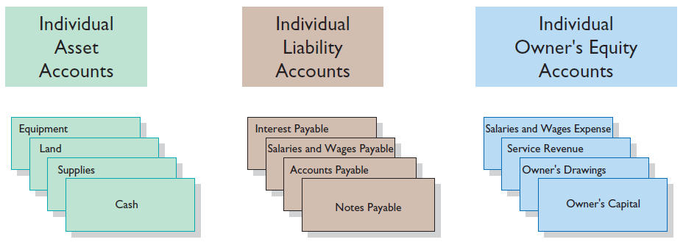
Explain how a ledger and posting help in the recording process.
The Ledger
General Ledger contains all the asset, liability, and owner’s equity accounts.
Illustration 2-15

Slide 10
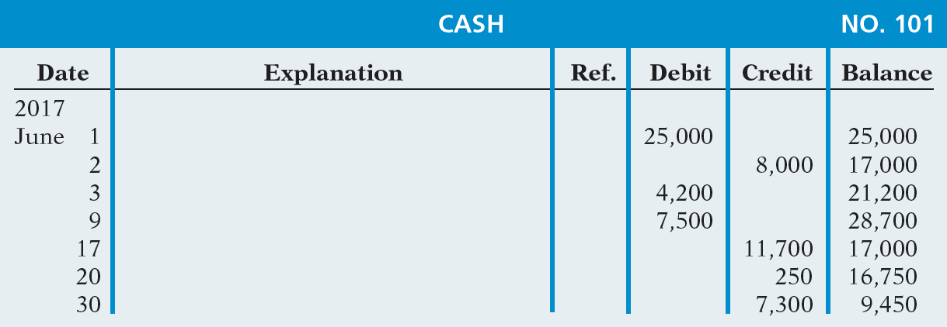
The Ledger
STANDARD FORM OF ACCOUNT
Illustration 2-16
Three-column form of account

Slide 11
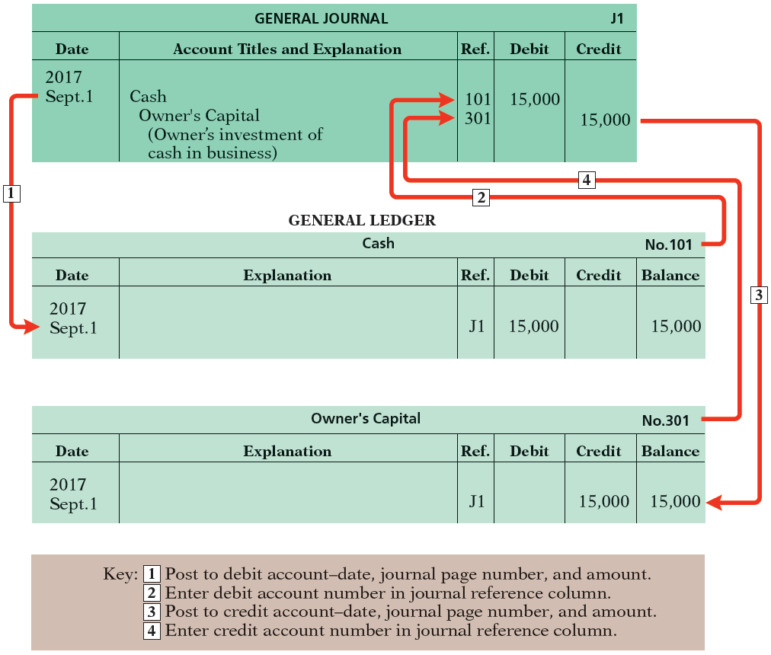
Ledger
POSTING Transferring journal entries to the ledger accounts.
Illustration 2-17
Posting a journal entry

Slide 12
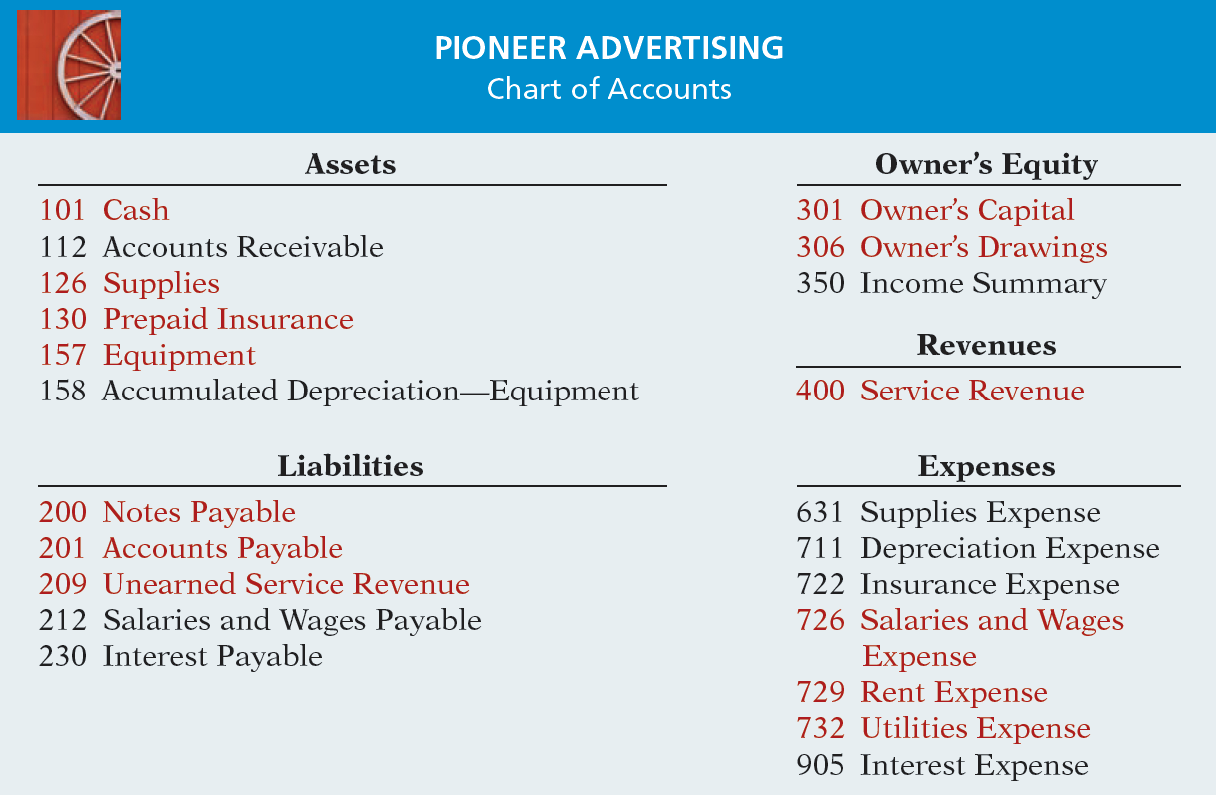
Chart of Accounts
Illustration 2-18

Slide 13
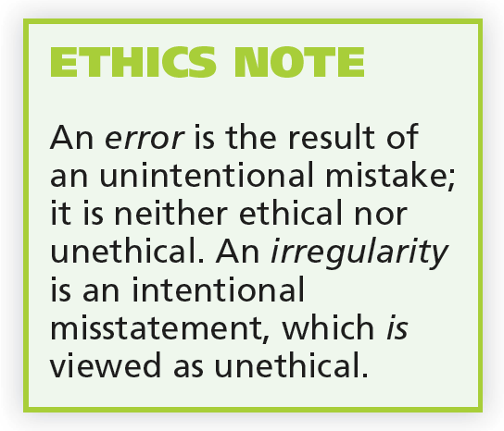
Trial Balance
Limitations of a Trial Balance
Trial balance may balance even when:
  A transaction is not journalized.
  A correct journal entry is not posted.
  A journal entry is posted twice.
  Incorrect accounts are used in journalizing or posting.
  Offsetting errors are made in recording the amount of a transaction.

Slide 14
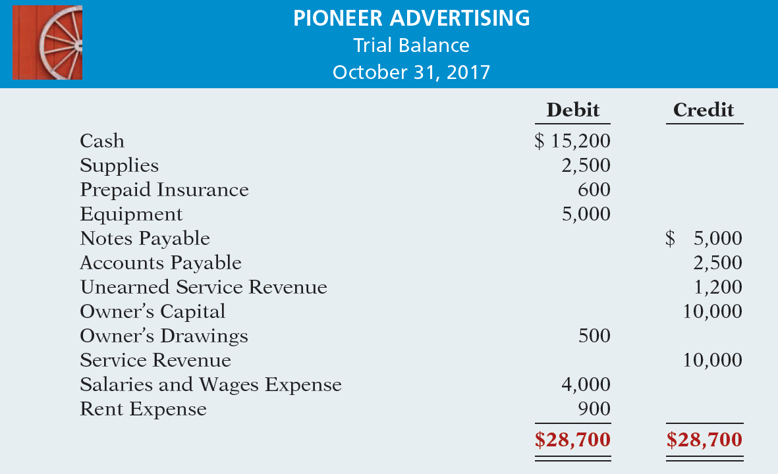
Prepare a trial balance.
Illustration 2-31

Slide 15
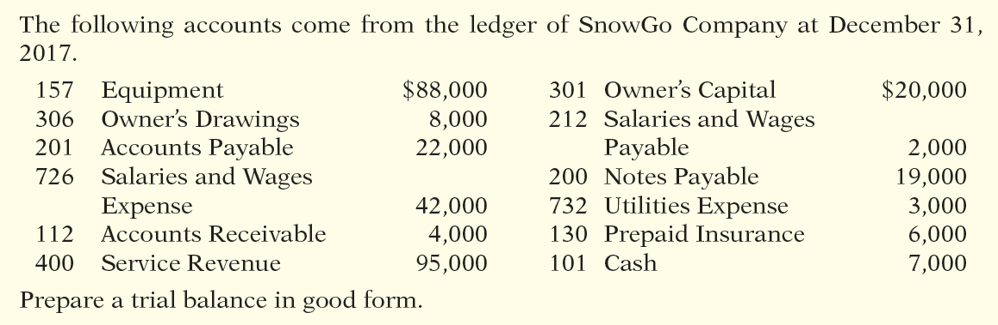
Trial Balance

Slide 16
Problem-1
Desiree Clark is a licensed CPA. During the first month of operations of her business, the following events and transactions occurred.
May 1 Clark invested $20,000 cash in her business.
2 Hired a secretary-receptionist at a salary of $2,000 per month.
3 Purchased $2,500 of supplies on account from Read Supply Company.
7 Paid office rent of $900 cash for the month.
11 Completed a tax assignment and billed client $3,200 for services provided.
12 Received $3,500 advance on a management consulting engagement.

Slide 17
Problem-1 (Continue)
17 Received cash of $1,200 for services completed for C. Desmond Co.
31 Paid secretary-receptionist $2,000 salary for the month.
31 Paid 60% of balance due Read Supply Company
Desiree uses the following chart of accounts: No. 101 Cash, No. 112 Accounts Receivable, No. 126 Supplies, No. 201 Accounts Payable, No. 209 Unearned Service Revenue, No. 301 Owner’s Capital, No. 400 Service Revenue, No. 726 Salaries and Wages Expense, and No. 729 Rent Expense.
Instructions
(a)Journalize the transactions.
(b)Post to the ledger accounts.
(c)Prepare a trial balance on May 31, 2012.

Slide 18
Problem-2
San Jose Services was formed on May 1, 2012. The following transactions took place during the first month.
Transactions on May 1:
1 Jarron Gilbert invested $40,000 cash in the company, as its sole owner.
2.Hired two employees to work in the warehouse. They will each be paid a salary of $3,050 per month.
3. Signed a 2-year rental agreement on a warehouse; paid $24,000 cash in advance for the first year.
4.Purchased furniture and equipment costing $30,000. A cash payment of $10,000 was made immediately; the remainder will be paid in 6 months.
5.Paid $1,800 cash for a one-year insurance policy on the furniture and equipment.

Slide 19
Problem-2 (Continue)
6.Purchased basic office supplies for $500 cash.
7.Purchased more office supplies for $1,500 on account.
8.Total revenues earned were $20,000—$8,000 cash and $12,000 on account.
9.Paid $400 to suppliers for accounts payable due.
10. Received $3,000 from customers in payment of accounts receivable.
11.Received utility bills in the amount of $350, to be paid next month.
12.Paid the monthly salaries of the two employees, totalling $6,100.
Instructions:
(a) Prepare journal entries (b) Post the journal entries
(c) Prepare a trial balance as of May 31, 2012.

